Slide 1
NETL’s Minority Serving Institutions Program
Welcome to the Webinar
November 9, 2016

Slide 2
Welcome and Introductions
The objective of this Webinar is to assist officials at Minority Serving Institutions (MSIs) by
Increasing the awareness of NETL’s Historically Black Colleges and Universities and Other Minority Institutions (HBCU/OMI) Program and its available opportunities
Presenting the context for these opportunities: NETL’s Mission and Priorities
Reviewing NETL’s engagement with Minority Serving Institutions and its purpose
Briefing participants on the intricacies of doing business with the Federal Government and how to effectively respond to NETL Funding Opportunity Announcements (FOAs)

Slide 3
Welcome and Introductions
This Webinar is being recorded and will be posted (in 7-10 days) on the NETL Website: www.netl.doe.gov. Go to the “Events” link on the upper left-hand side.
If you are using the option with computer audio, you may experience audio issues depending on your internet connection speed. To avoid that possibility, we recommend that you use the phone call option.
Your telephones are muted and we will not be able to hear your questions, so please use the chat/question box that came up when you logged onto GoToWebinar for your questions. All questions will be answered, time-permitting, after all the presentations have been made.
Questions that are not answered during the Webinar will be posted, along with the answers, at the same location as the Webinar recording.

Slide 4
Agenda
Welcome and Introductions – Maria Reidpath, Project Manager, Enabling Technologies and Partnerships
Overview of NETL’s Mission and Activities – Robert Romanosky, Technology Manager for Crosscutting Research and Analysis
Overview of Crosscutting Technology Research and Analysis Program – Richard Dunst, Project Manager, Enabling Technologies and Partnerships
NETL’s Engagement of Minority Serving Institutions – Maria Reidpath, Project Manager, Enabling Technologies and Partnerships

Slide 5
Agenda
Doing Business with the Federal Government – Nicole Murray, Contract Specialist, Financial Assistance
Responding to the Areas of Interest (or Topics) – Sydni Credle, Project Manager, Crosscutting Research Division
Funding Opportunity Announcements (FOAs) – Nicole Murray, Contract Specialist, Financial Assistance
Questions and Answers

Slide 6
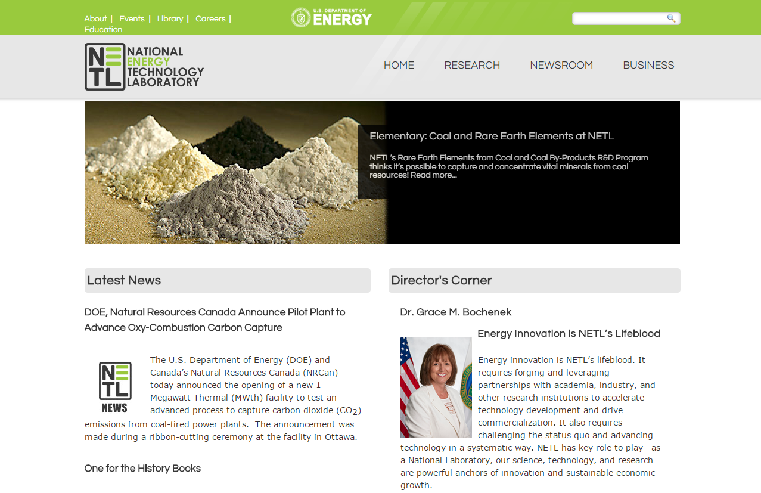
Contact Information
For questions on the Crosscutting Research and Analysis Program contact Robert Romanosky, Ph.D.
robert.romanosky@netl.doe.gov
For questions on the HBCU-OMI Program contact Maria Reidpath
maria.reidpath@netl.doe.gov
Visit NETL’s website: www.netl.doe.gov

